Slide 1


Tobacco-Free
Signage Examples
Version: 2023

Slide 2
Basic Signage Updates
Notes:
This section will mention some basic aspects to consider as a clinic plans to update tobacco-free signage

Slide 3


Update to “No Smoking, No Vaping” or “Tobacco-Free” text
Notes:
Source for the first image: https://www.tecc.org/product/no-smoking-no-vaping/
No Smoking No Vaping / Sign
A great general use sign that addresses not only smoking but vaping and marijuana use as well.
When professionally printed, the sign can be mounted on a wall or attached to a fence or post.
Did you know that this material, and others, can be personalized? Visit TECC’s MatBuilder home page to learn more and to explore your options!
Available in seven languages.

Slide 4
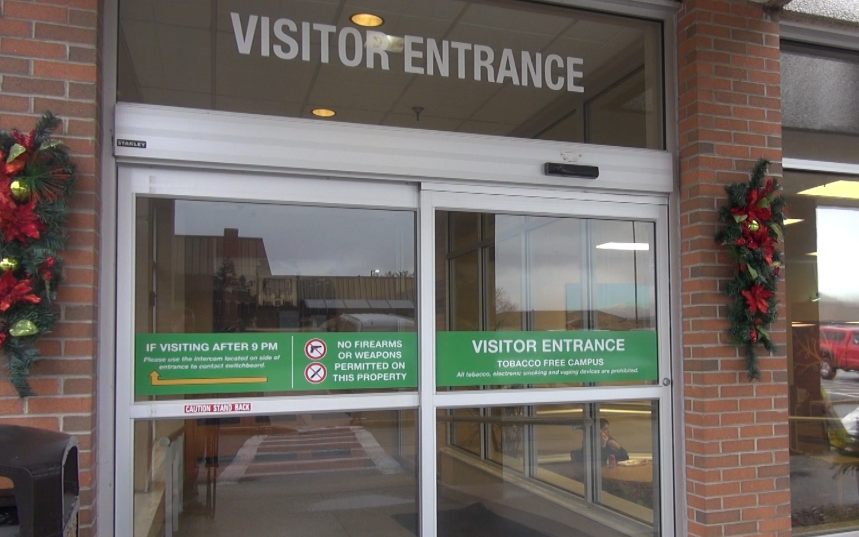
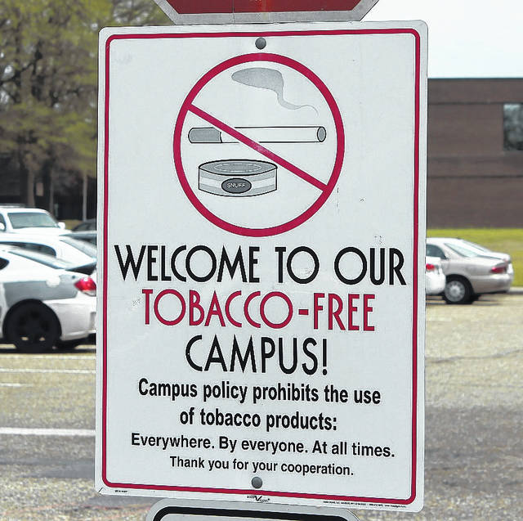
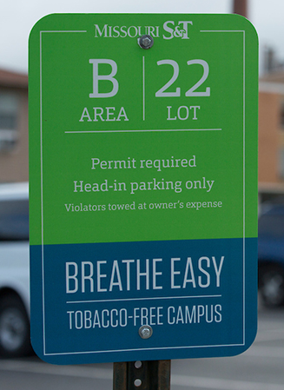
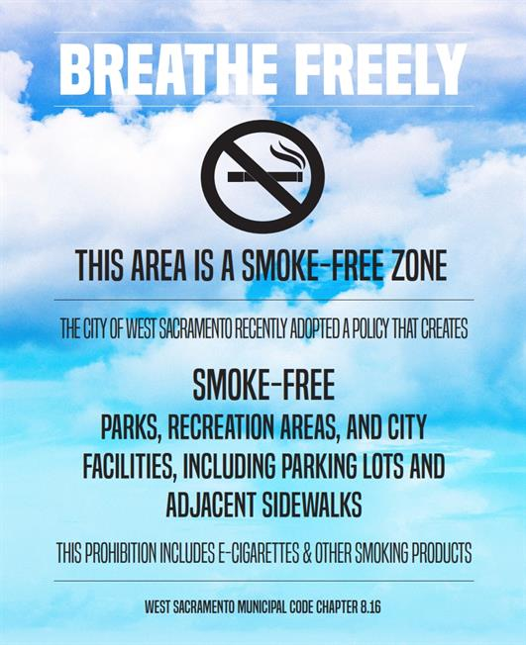
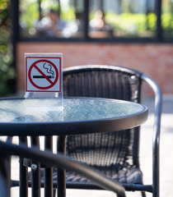
Post at entrances and tobacco-free outdoor areas
Notes:
Post updated signage to key areas to expand the visibility of the tobacco-free policy, and clarify which areas are tobacco-free

Slide 5


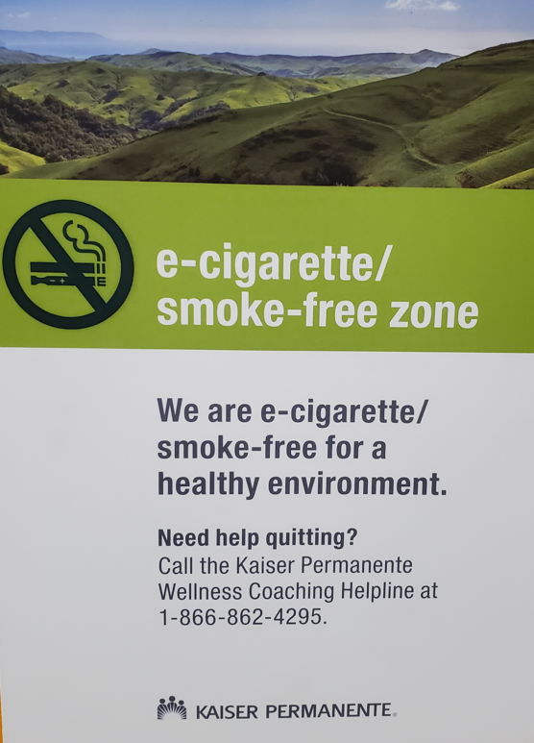

Tailor for language and include cessation support info
Notes:
Post signage in different languages to make the information more accessible. In addition, consider adding relevant cessation resources.

Slide 6
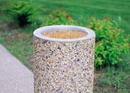
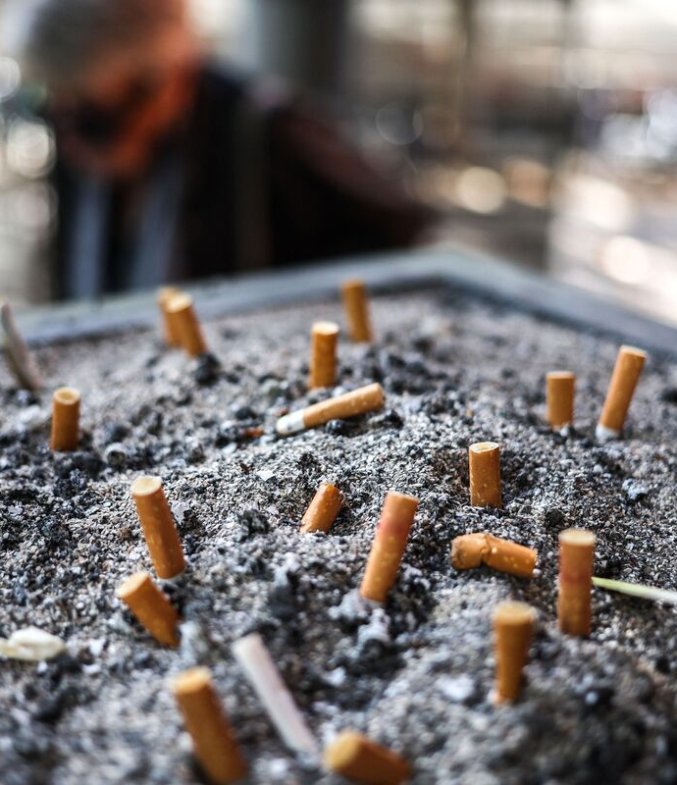
Remove tobacco trash and receptacles
Notes:
These receptacles often smell like tobacco products and can trigger cravings and relapse for those trying to quit. They also send mixed messages about whether a space is tobacco-free

Slide 7
Other Ideas

Slide 8




Visually show types of tobacco prohibited at the clinic
Notes:
Choose signs that contain images, for more of an at-a-glance effect

Slide 9

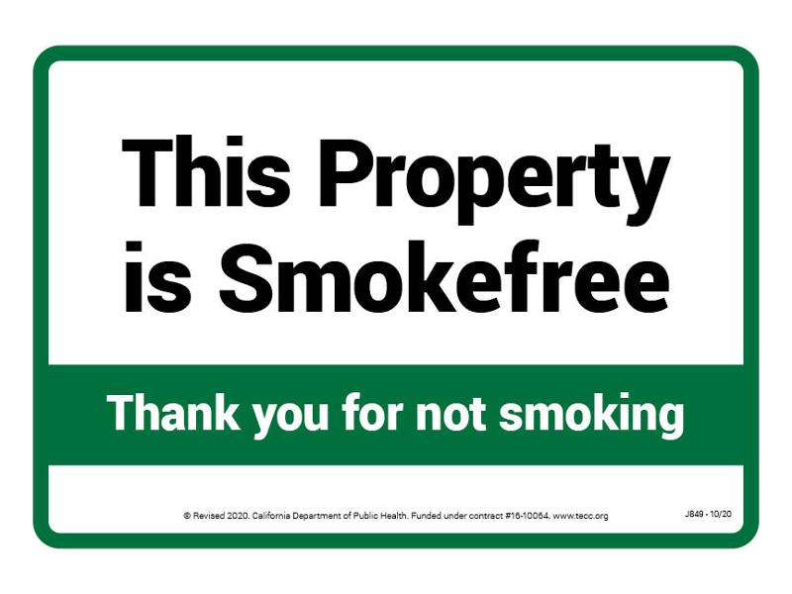

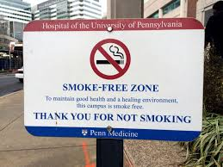
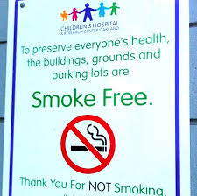
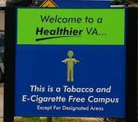
Mix in some more friendly signs / posters to affirm value
Notes:
Some paces like interiors of staff lounges, cafes, or entryways can have more polite/friendly reminders

Slide 10
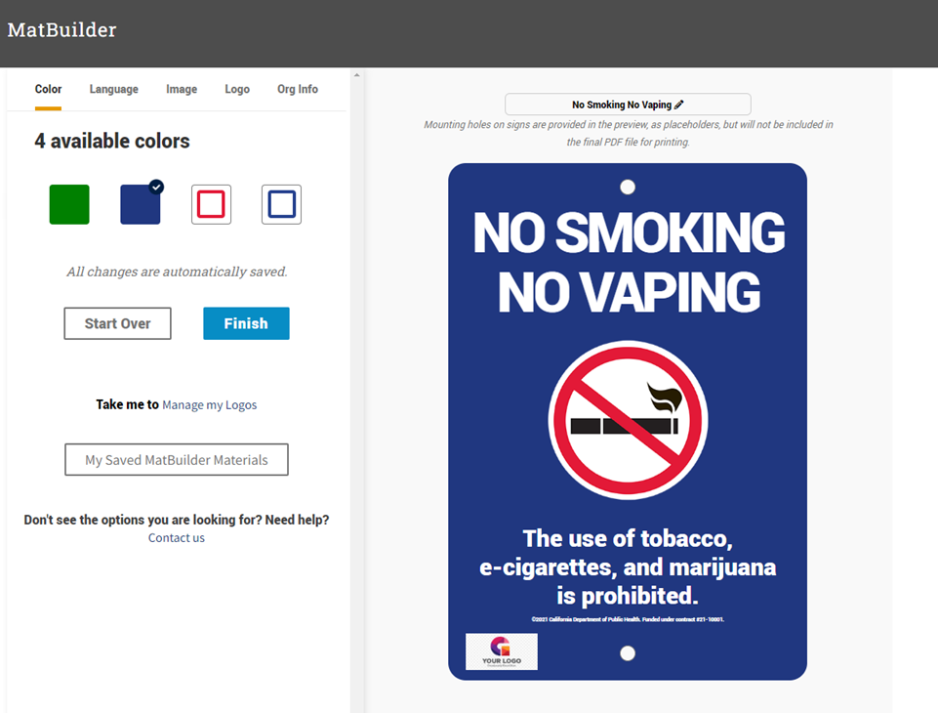
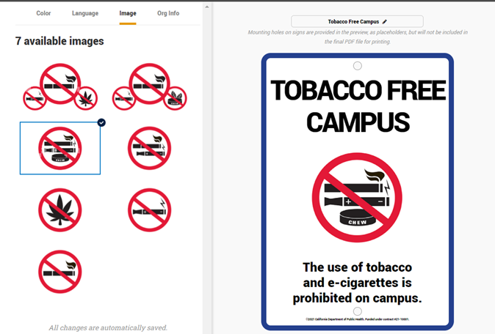
Web tool for customizing signage
Free account to access the tool
Change color, image, language
Add logo
Add other text
https://www.tecc.org/matbuilder/about-matbuilder/
Notes:
Tool accessible for free to all CA non-profits and tobacco prevention projects

