Slide 1

Academic Personnel
Monthly Information Session
Presented by the Office of Academic Personnel
Stephanie Celestin, Nicole Steele, Lisa Reevesman, Amy Edwards
September 30, 2025
1

Slide 2




Housekeeping
Please keep yourself muted during the presentation
Ask questions in chat
Please keep your camera on during the presentation

Slide 3

Agenda
Annual Call 2025-2026
Academic Advancements: New Items, Updates and Reminders
Department Letters: 2025-2026
Recruitment: Reminders
Non-Faculty: Reminders
Notes:
Stephanie
Welcome Everyone
Today we will be discussing the 2025-26 Annual Call and some general items related to the academic review process for the upcoming 25-26 advancement cycle.

Slide 4
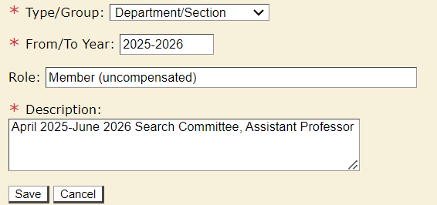
2025-2026 Annual Call – Academic Advancements-New
Service in MIV: When possible, please provide months in the description in addition to years when entering service into MIV. Please clarify as well whether/how service was compensated (e.g. course release, stipend, or neither).
Rationale: CAP and reviewers want to understand if the academic service spanned over 1 year or just a few months.
Recommendations:
List months of service in the Description field of MIV vs From/To Year. MIV sorts alphabetically not chronologically when alpha characters are used.
Notify faculty now, so they can provide the months of service within their CVs for 26/27 reviews.
If service is uncompensated, include “uncompensated” in Role field.
Notes:
STEPHANIE
Hello, Today we will review several new’ items in the Annual Call as well as clarifications, reminders and extensions. Unfortunately, we just don’t have enough time to review all the Call today, so as always, we encourage you to independently review the Annual Call for more information.
1. For example, an academic who aspires to accelerate their advancement by one year to the associate rank should have a scholarly record in the one year since last review that is consistent with the record that would be expected in a two-year period. Additionally, an academic who aspires to accelerate advancement by two years to the full rank should have a scholarly record in the one year since last review that is consistent with the record that would be expected in a three-year period. There are no similar expectations for exceeding normative time expectations, however, for teaching and university/public service performed in the abbreviated time period.

Slide 5
2025-2026 Annual Call – Academic Advancements-New
Accelerated Promotions: When evaluating accelerated promotions actions for a positive recommendation, reviewers should specifically evaluate if the research/creative activity work performed in the abbreviated period of time is commensurate with what would be expected in the normative time period.
Examples:
An academic who aspires to accelerate their advancement by one year to the associate rank should have a scholarly record in the one year since last review that is consistent with the record that would be expected in a two-year period.
Additionally, an academic who aspires to accelerate advancement by two years to the full rank should have a scholarly record in the one year since last review that is consistent with the record that would be expected in a three-year period.
There are no similar expectations for exceeding normative time expectations, however, for teaching and university/public service performed in the abbreviated time period.

Slide 6
2025-2026 Annual Call – Academic Advancements
Updates to Optional Statements
Statement of Achievements Relative to Opportunities (New)
    Subsumes COVID-19 Statement and Strike Impact Statement
    Currently no page limit
    Emphasis placed on the quality and impact of achievements rather than their quantity, taking personal and professional circumstances into account.
Statement of Contributions to Public and Global Impact
    Currently no page limit
    This statement highlights the connectedness and overall impact of a candidate’s public or global contributions across research, teaching, and service, providing an opportunity to tell the story of their scholarly impact that may not be evident in the Candidate’s Statement.
Candidate Statement
    6-page limit
    Subsumes Diversity Statement
Notes:
STEPHANIE

Slide 7
2025-2026 Annual Call – Academic Advancements
Updates
Linking Actions in MIV
  Appraisals
    Linking merits and appraisals is no longer available in MIV
    Create 2 separate actions in MIV
  Appeals
    Create appeal action in MIV
    Link to the original merit or promotion
    Do not request a new packet
Notes:
STEPHANIE

Slide 8
2025-2026 Academic Advancements - Reminders
Helpful Reminders for Academic Reviews
Refer to the APM advancement policies, Academic Affairs Forms & Checklists, Delegations of Authority, and SOM MIV User Guide.
RA Unit Members: Candidates must be provided six weeks to submit their materials once they are notified of eligibility to advance. Include the "Notification of Advancement Eligibility or Academic Federation member“ form with email notification.
Appraisals and Five-Year Reviews may not be deferred.
Deferrals and Five-Year reviews are due at the same time of the respective action deadline.
For “declined” merits that do not route via MIV (merit at Professor, Step 5 or above), submit a written notice/email from the candidate that includes the Chair acknowledgement to your AP Analyst.
Notify your AP Analyst when an action has been routed to the School/College level in MIV.
Notes:
NICOLE

Slide 9
2025-2026 Academic Advancements - Reminders
Department Letter: First paragraph, add the % effort of job responsibilities- does not need to be exact for all categories.
Peer Review of Teaching: The letter should contain analysis of direct teaching activities- clinical patient care, operating room procedures, hospital rounds, research mentorship, and residency program teaching sessions (UCD 220). The letter should include how the instructor prepared for the lecture, the effectiveness of the instruction, and how the course/lecture was received by the participants, ex: grand rounds and didactic lectures.
Teaching Evals: if less than 4 respondents, include the session and score with a comment that “there are less than 4 respondents, therefore the link is unavailable”.
Notes:
NICOLE
Peer Review: Reminder, seen several come through that list the teaching that was done, which is already in the dossier, but we need a direct analysis of the instruction. Template has been used. If actual classroom teaching happened, analysis of classroom teaching, as well as an assessment of teaching materials, assignments, and examinations can be discussed as well.
UCD 220 evaluation by department or other campus colleagues should assess the course’s scholarly content and the apparent effectiveness of classroom instruction, and should also evaluate teaching materials such as course syllabi, websites, other online resources, exams, lecture notes, study guides and assigned readings

Slide 10
2025-2026 Academic Advancements - Reminders
Honors and Awards: Reminder that candidates are expected to provide the 1) name of the organization conferring the award, 2) the reason for the receipt of the award, 3) the award’s professional significance, 4) the year the award was received, 5) link to the award, if available (recommend adding “link not available”, if none).
Grants and Contacts: Only active and completed items during the review period should be included. Reminder, Off-Campus amount needed for active grants.
List of Service and Evaluations: Add terminal degree line for promotions to Associate only.
Solicitation letter: Reminder to use templates from APM UCD-220 (Exhibit B) and HSCP templates to ensure all required language is included.
Notes:
NICOLE
Honors/Awards: Faculty Receiving Awards During the Review Period: Many actions
contain references to awards that are unknown to reviewing bodies.
Line drawing-only include a line for anything resulting in an advancement (appraisal, deferral not needed)

Slide 11
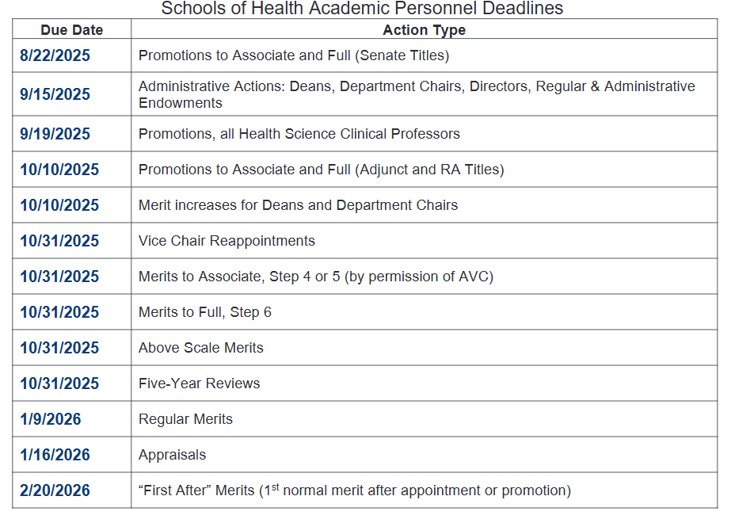
2025-2026 Academic Advancements - Deadlines
VP-AA Deadline (Non-Redelegated Actions)
Due Date
11/14/25 & 12/12/2025
1/9/2026
1/9/2026
1/30/2026
1/16/2026
1/30/2026
2/20/2026
3/13/2026
Notes:
NICOLE
UPDATE NICOLE
Deadlines based on action type
We continue to grow, over 700 advancement actions FY 25-26
Refer to VP-AA Annual Call, Appendix A
Dr. Cocanour and Dean Murin need time to review; review committees

Slide 12
2025-2026 Academic Advancements - Extensions
Extension Request Process
Schools of Health AP Deadlines:
Requests must be submitted prior to the Schools of Health AP Deadlines
Extension request may not exceed 30 days beyond the Health AP Deadline
For subsequent extension requests, include the Chair concurrence
VP-AA Deadlines:
Accelerated promotions are ineligible for extensions
Requests must be submitted to AP Analyst prior to VP-AA Deadlines, Appendix A
No more than (2) 2-week extensions will be allowed
Include strong justification with the Department Chair concurrence
Interim AVC will review/provide concurrence
VP will review/approve
Notes:
NICOLE
Extensions:
Email your AP Analyst
1. Reason for the extension request
2. Anticipated date of submission (not to exceed 30 days)
- No more than two (two-week) extensions will be granted to the academic, and if the dossier is not submitted at the end of the second approved extension, then the action will become an administrative deferral. Eligibility will be updated to the next review cycle unless an exception with strong justification is approved by the Vice Provost.
When delays are due to department or dean’s office staffing concerns, no more than a total of two (two-week) extensions will be granted, and if the dossier is not submitted at the end of the second approved extension, then the action will become an administrative deferral. Eligibility will be updated to the next review cycle unless an exception with strong justification is approved by the Vice Provost.
In the case of joint appointments, extensions should be requested by the home school/college only.
Accelerated promotion actions are voluntary and not eligible for extensions. Accelerated promotions due to the candidate not making submitting their materials by the deadline will not be reviewed.
Any non-redelegated action received after May 31, 2025 may be subject to administrative deferral and can be submitted in the next review cycle.

Slide 13
2025-2026 Academic Advancements
Department Letters 2025-2026
Academic Personnel is collaborating with the FPC Committee to streamline how data is shared with reviewers for appointments and advancements.
  Opportunity to include within the Department Letter required information for reviews that is helpful to FPC committee—such as % effort, review period, and advancement history
  Can help inform voters and reviewers
  Example
Department Letter Addressee:
        Christine S. Cocanour, MD, FACS, FCCM
      Associate Vice Chancellor
      Schools of Health
      Office of Academic Personnel
Notes:
STEPHANIE
Department Letters: Department letters should now be addressed to our Associate Vice Chancellor for the Schools of Health, Dr. Christine Cocanour.
Please update your department letters accordingly

Slide 14
2025-26 Annual Call - Recruitment
STEAD Campus Workshops – 4 years
Mandatory for Senate Faculty Search Chairs
New courses added for Sept/Oct/Nov https://academicaffairs.ucdavis.edu/stead-faculty-search-committee-workshop
Faculty Search Committee Chairs of Non-Senate and Members Senate/Non-Senate Faculty recruitments will satisfy the STEAD requirement by attending the Enhanced Training for Faculty Search Committee Members offered online
https://health.ucdavis.edu/facultydev/events/upcoming-events.html
Notes:
LISA
NEW: STEAD is now required every four (4) academic years. Those who took training in 2021-22 are now be certified through June 30, 2026.
CHANGE: SOM/SON Search Committees chairs for Academic Senate recruitments will be required to be STEAD certified by attending the campus STEAD workshop offered via in person or Zoom.
SOM/SON Non-Senate Faculty Search Committee Chairs and all members (Senate or Non-Senate) will satisfy the STEAD requirement by attending the “Enhanced Training for Faculty Search Committee Members” offered via LMS.

Slide 15
2025-26 Annual Call - Recruitment
Conflict of Interest Reminder
  Conflict of Interest Form is due at the time the shortlist is filed.
  Faculty form: https://aadocs.ucdavis.edu/your-resources/forms-and-checklists/forms/faculty-recruitment-committee-coi-statement-and-form.pdf
  Non-faculty form: https://aadocs.ucdavis.edu/your-resources/forms-and-checklists/forms/non-faculty-recruitment-committee-coi-stmt-and-form.pdf
  Upload in UC Recruit under the “Documentation” section.
Notes:
LISA
Be sure that the search committee chair reads and fills out the COI form appropriately. It is okay for a search committee member to disclose a potential conflict. All we are asking is that the potential COI is openly discussed and documented. A PCOI could be for a former mentor, colleague or personal friend of a search committee member.
Shortlists Reports will not be reviewed or moved forward for final decision until the COI Statement and Form is added to the recruitment under the documentation section.

Slide 16
Faculty Recruitment Employee Disclosure
(Effective January 1, 2025)
1. Requirements
  -- All recruitments and direct hires (waivers, exemptions, postdocs, students, volunteers) must include required language either in the job description or at the start of direct hire discussions.
2. Candidate Awareness & Authorization
  -- Candidates will be informed of the process through recruitment language or via email for direct hires.
  -- Each candidate must sign an Authorization to Release Information as part of their application materials.
3. Hiring Dean’s Office Survey
  -- Academic Personnel initiates the hiring department survey for the proposed candidate.
  -- The Recruitment Team Analyst or Non-Faculty Analyst hand will submit the Hiring Survey.
  4. Candidate Disclosure
  -- Academic Affairs will contact the candidate and request completion of the Employment Disclosure Questionnaire.
  5. Clearance Notification
  -- Academic Affairs will notify the Recruitment Team once clearance is determined.
  -- A team member will inform the Department of the clearance status within 72 hours.
  6. Job Offer & Appointment
  -- If the candidate is cleared, proceed with a TOL.
  -- Upon acceptance of the TOL:
    The Department proceeds with the appointment.
    Attach the clearance email to the Department letter for routing in MIV.
    For non-MIV appointments, attach the approval email to the Aggie Service Case onboarding case.
Notes:
LISA
Upon receipt of the recruitment search report, the Recruitment Team member will initiate the hiring survey. This is for the faculty and RA Unit recruitments.
Upon approval of the search waiver or exemption, the team member will initiate the hiring survey.
Your RT analyst will email the clearance email, but you can also find it in the RTL so generalists, clusters and department analysts can find it. You will see the date we submitted it and once cleared, the clearance itself will be uploaded.
For change in title that does not require the disclosure (maybe the candidate has been her more than 7 years), Academic Affairs will let us know how to proceed. Please continue to request the Authorization to Release Information and provide them with the required language as though it is needed. For LR it will be necessary because of the misconduct check.
TOLs cannot go out in writing until the disclosure is cleared.

Slide 17
Junior Specialist - Reminders
Jr. Specialists Recruitments: Candidates may only be hired into titles/steps that are included in the recruitment. If there is a possibility of part-time and full-time options, include the NEX job code 003329 and the exempt job code 003330.
- Recruitments may include Step 1 and Step 2 salaries.
Applicant Qualifications: Candidates with a Master’s degree may not be hired as a Jr. Specialist. If the candidate will obtain a Master’s degree during the appointment term of their Jr. Specialist appointment, they may only be hired for a 1-year appointment and are not eligible for reappointment. These candidates should be hired at Step 2.
Jr. Specialist Reappointment Guidance: Absent serious performance issues, a Jr. Specialist reappointed for a second year in that title must be moved from salary step 1 to salary step 2.
  Please refer to the junior-specialist-reappointment-checklist.pdf.
Jr. Specialist Promotion to Assistant Specialist: Jr. Specialist are eligible for promotion if they are currently appointed at Step 2 and if they were hired through an open recruitment.
  Please refer to the Checklist—Project (e.
Notes:
AMY

Slide 18


Questions
Notes:
Jen

Slide 19

Upcoming Session-Tuesday October 28th
Thank you for your attendance today!!!
Notes:
Jen
Our next information session will be on Tuesday October 28th hosted by the Non-Faculty Team
Thank you for attending today.

