Slide 1

Brown Bag:
Academic Personnel Updates 2022/2023
Presented by the Office of Academic Personnel
September 13, 2022
1

Slide 2

Agenda
Annual Call 22/23
Academic Personnel –packet preparation
Peer Review of Teaching
Extramural Letters
MIV Updates & User Guide
Teaching Evaluations
Deadlines & Extensions
Process for submitting Junior Specialist appointments and reappointments
Junior Specialist 3rd year reappointment by exception
Process for submitting Postdoc appointment and reappointments
Postdoc 6th year reappointment by exception and transition plan
Background check and Tracker reminder
TOL Submission Process
Pre-Hire Process
Faculty & Professional Development Overview and current course offerings
2

Slide 3

Annual Call Academic Reviews – New Updates
ANNUAL CALL: NEW UPDATES
Distinguished Professor Emeritus: For faculty who are at Professor, Step 9 or 9.5 and who will be retiring before advancing to Above Scale, department(s) may prepare a dossier requesting the title “Distinguished Professor Emeritus” that would be forwarded to the Dean’s office and to CAP per the Delegation of Authority and assessed by the standards of UC APM 220-18.b.4. This action would need to be completed in the year of the faculty member’s retirement. If approved, this title would be conferred upon retirement. This process is a change in title only and will not result in advancement to Above Scale. Faculty who retired on August 31, 2020, or later and were either at Step 9 or Step 9.5 will be eligible to retroactively go through this process. Actions will need to be submitted in the academic year 2022-2023.
Peer Evaluation of Teaching for Any Action: Faculty can request a peer evaluation of teaching for any action in order to provide a more balanced perspective on their teaching record beyond student evaluations.
Items to Include with Extramural Letter Requests: While UC Davis has recently encouraged departments to utilize a more holistic evaluation process for advancements due to the deleterious impact of the pandemic on academic careers, extramural letter writers may not be aware of this. Therefore, when seeking extramural letters, we recommend that Department Chairs also consider including with the request the candidate’s statement, a statement of contributions to diversity, equity, and inclusion, and, if available, the COVID opportunities and challenges statement. Any of these items provided to extramural letter writers should first be approved by the candidate, as some faculty may not wish these documents to be shared outside the university.
Jr. Specialist Reappointment Guidance: Absent serious performance issues, a Jr. Specialist reappointed for a second year in that title must be moved from salary step 1 to salary step 2.
COVID Impact Statements in MyInfoVault (MIV): COVID impact statement should be uploaded into MIV as “COVID Opportunities and Challenges Statement.” This should no longer be included as the 6th page of a Candidate’s Statement.
3
Notes:
Announce before slides: A lot of these topics will be covered more in depth through this presentation.

Slide 4


MIV Packet Preparation – Common Errors
Department Letter
Make sure that the vote count is correct and that it adds up to the total faculty eligible to vote
MUST include no votes in the vote count and the comments in the department letter
If the department supports step plus indicate the specific domain (Research, Service, and Teaching) that the additional step supports
% of Clinical effort (Required for ClinX), and for Adjunct Professors the % distribution of research and teaching.
Add the proposed step in the department letter, not TBD
Packet
Double check that the links are active and not broken for all required categories that are required to have links published/In press publications, book chapters, evaluations, and editorial reviews
Ensure that the correct title code, % of appointment, series, years at rank/step, action type, and delegation, are accurate on the Action Form
Draw a line for the current review period, since the last action. Previous lines should remain for the future, especially for promotion actions and actions that cross barrier steps
Add asterisks under Publications for the current review period
For Project Scientists, Specialists, Professional Researchers and Adjunct Professors, Include Notice of Eligibility. Position Descriptions required for merit/promotion review for Project Scientists, Specialists and Professional Researchers
Include Contributions to Jointly Authored Works
Candidate Statement maximum of 5 pages

Slide 5

Peer Review of Teaching
WHAT is a Peer Review of Teaching?
A peer evaluation of teaching is a letter that provides a more balanced perspective on their teaching record beyond student evaluations. It includes a substantive peer of classroom teaching, direct clinical care, operating room procedures, hospital rounds, research mentorship and residency program teaching sessions.
WHEN is a Peer Review needed?
Required: A peer review of teaching is required for all faculty promotion advancements.
Optional: Faculty can now request a peer evaluation of teaching for any action in order to provide a more balanced perspective on their teaching record beyond student evaluations.
5

Slide 6

Peer Review of Teaching
WHO can provide the review letter?
The peer review of teaching must be provided by a member of the Academic Senate either within the candidate’s department or other campus Senate colleagues.
WHERE does the completed review letter go?
The completed and signed letter is uploaded by the department AP analyst in the “Peer Evaluation of Teaching” section in MIV under the candidate’s open action.
Policy and Resources:
APM 220 V.B.6.b (page 15)
Peer Review of Teaching Template
Promotion and Merit checklists showing Peer Evaluation of Teaching letter information
6

Slide 7

Extramural Letter Requests
New-Optional items that may be included with extramural letter requests:
  Candidate’s Statement
  Statement of Contributions to Diversity, Equity and Inclusion
  COVID Opportunities and Challenges Statement (if available)
Reminder - Extramural letters should be solicited from faculty of a rank equal to or above the rank sought by the faculty member.
7
Notes:
While UC Davis has recently encouraged departments to utilize a more holistic evaluation process for advancements due to the deleterious impact of the pandemic on academic careers, extramural letter writers may not be aware of this. Therefore, when seeking extramural letters, we recommend that Department Chairs also consider including the above items with the request. Any of these items provided to extramural letter writers should first be approved by the candidate, as some faculty may not wish these documents to be shared outside the university. (OPTIONAL)

Slide 8

Review Changes to Letter Requirements
Lecturers with Potential Security of Employment
  Lecturers PSOE promoting to Lecturer with Security of Employment will require 6-8 extramural letters, half of which must be arm’s length
Adjunct and Health Sciences Clinical Professor (HSCP) Series
  Extramural letters are no longer required for Adjunct Professors and Health Sciences Clinical Professors (HSCP) undergoing merit reviews that cross the full rank, Step 6 barrier
8
Notes:
Extramural letters are no longer required for Adjunct Professors and Health Sciences Clinical Professors undergoing merit reviews that cross the full rank, step 6 barrier. Extramural letters are optional, and if requested, the regular procedure for soliciting letters must be followed.

Slide 9

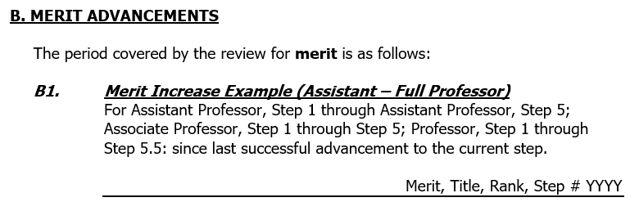
Academic Review Packet Line Drawing for Review Period
In MIV, lines should include the action, effective date, rank and step for all previous actions
Updated “Where to Draw the Line” on our AP website under the academic advancement actions page.
9
Notes:
Reminder: Be sure to draw a line to indicate those materials that have been added since last approved action, if applicable. Previous lines drawn should remain for future actions, especially for promotion and barrier step advancements.
The “Where to Draw the Line” has been updated and will be available for reference on the AP Website.

Slide 10


MIV Updates
New
New- Impacts of COVID-19: The COVID impact statement should be uploaded into MIV as “COVID Opportunities and Challenges Statement.” This should no longer be included as the 6th page of a Candidate’s Statement.
Reminders
Reminder- Contracts/Grants: The VPs office now requires the On-Campus Amount (Total dollar amount to be received by UC Davis for this grant), Off-Campus Amount (Total dollar amount overall, including any funds allocated for this grant at other institutions (i.e., outside of UC Davis), Number of PIs/Co-PIs, and a List of all PIs and Co-PIs for all grants awarded within the review period.
Reminder- Honors/Awards: The VPs office requires the name of the organization conferring the award, the reason for the receipt of the award, the award’s professional significance, the year the award was received, and a link to the award, if available.
Reminder- Editorial/ Journal Reviewer Service: The VPs office now requires that we provide the # of reviews managed/completed within the review period (example: July 1, 2019 - June 30, 2022).
Notes:
There is a place to upload the Covid Opportunities and Challenges Statement within MIV in the candidate’s account under “Candidate’s statements”
Recommend requesting PI and funding amounts from faculty before entering information in MIV as it will not let you save without additional information now requried.
Honors and Awards reminder to uncheck and check for the review period only.

Slide 11
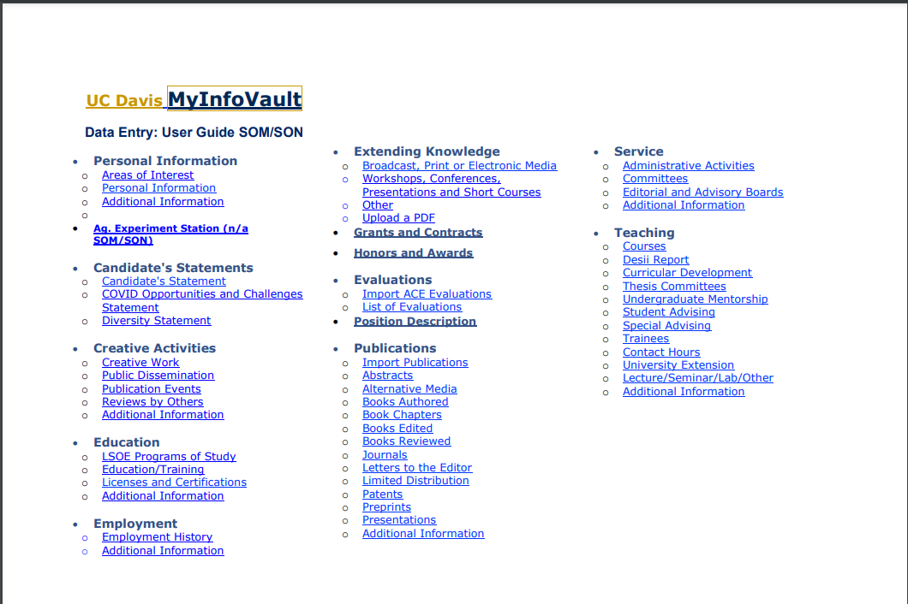
SOM/SON- MIV User Guide
MIV Data Entry User Guide can be found on the Academic Personnel Website and as a Quick Link
11
Notes:
The guide resembles the MIV Entry Main page and is interactive. Each section is a link that takes you to instructions for entering information and what information should be included in that section. Sections not used by the Schools of Health will include a link that says “do not use”

Slide 12

Voting Website
Kerberos IDs
  The system will now alert users if a duplicate faculty account or an account with an invalid Kerberos ID exists. This alert is messaged on the Manage System Menu
  Added warning/error messages will alert the user to either an Invalid Kerberos ID, or a Duplicate Account
  New vote postings cannot be created for faculty accounts that have warning/error messages. Errors must be corrected before creating a new posting
Account/Post Management
  If an account is Active, but the person is no longer with UCD, simply click on the “trash can” icon to deactivate it in one click
Group Restrictions
  The system now includes an option to create voting groups for voting restrictions. See “Manage Voting Groups” on the Manage System Menu
  Groups allow for restrictions on ballots, in which a department approved voting procedure only allows specific ranks or series to vote on an action
  Note, Manage Voting Groups is different from Voting Restrictions. Voting Restrictions is reserved for identifying faculty with near relatives’ relationships
12
Notes:
Email communication was recently sent from our office on the voting website updates.
Kerberos IDs: The voting website for the Schools of Health has undergone some changes over the past year. Most recently, it was updated to include features that alert users of duplicate accounts and to ensure that faculty have correct Kerberos Ids and emails tied to their accounts. If the Kerberos ID or email is invalid, a faculty member cannot vote on an action. We recommend as a best practice to ensure the Kerberos ID is updated with the correct email address in the system during the onboarding process to ensure newer faculty can vote on all actions once fully onboarded.
Account Management: If an account is active, but the faculty are no longer with UCD, you can now click on the trash can icon to deactivate the account.
Group restrictions: Were added to allow for departments with unique voting procedures to utilize the system. You can now create a group restriction that limits faculty from voting yet provides the opportunity to consult on ranks or series based on Academic Federation or Senate. Please note, this is different than voting restrictions within the system that blocks faculty from voting at all within the system and is used most often when faculty with near relative relationships are required to vote.
NOTE: If you have any questions or need additional training on this system, please feel free to contact Academic Personnel.

Slide 13

Teaching Evaluations
ACGME / University Rules for Teaching Evaluations
Per ACGME Anonymity requirements for all trainees, ANY reporting can only be in aggregate format and there MUST be 4 or more responses
  If there are less than responses 4 you CANNOT use the report - the faculty MUST wait
  Actual evaluation forms CANNOT be posted in MIV (even redacted)
There can be NO identifying information in the reporting
Fellowships should use the Residency evaluation form; delivery CANNOT be automated
  Residency program has shared the evaluation form with Fellowships
  This is newer requirement to ensure anonymity
The only report form for Trainee Evaluation of Faculty that can be used is the Aggregate without rotation dates, names of evaluators or services
Evaluations should have the anonymous comments included, whenever available
Academic Personnel is unable to pull evaluations from MedHub per the Office of Medical Education and Graduate Medical Education
1
Notes:
1. These are the ACGME Rules for Teaching Evaluations:
Reporting must be done in aggregate format, and there must be 4 or more responses.
If there are less than 4 responses, you cannot use the report.
Actual evaluation forms cannot be posted in MIV.
There can be no identifying information on the report.
Fellowships should use the residency eval form and cannot automate delivery.
The only report form for trainee evals that can be used is the Aggregate form without rotation dates, names of evaluators, or names of services.
2. Evals should have anonymous comments at the bottom.
3. AP cannot pull evals:
Per OME & GME, only the department education team is allowed to pull evals from MedHub.
If Departments need guidance or access to run evals in MedHub, please reach out to OME/GME.

Slide 14
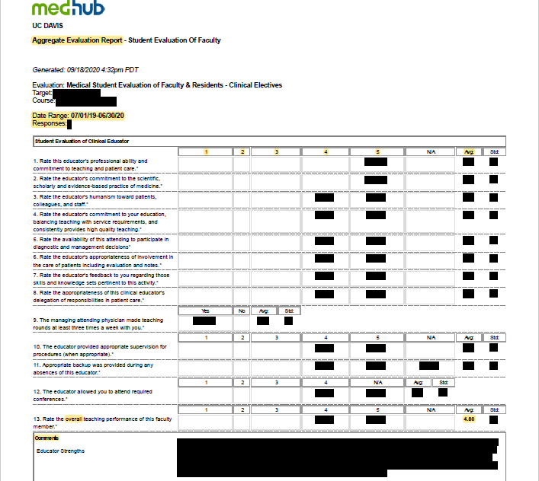
Teaching Evaluations
EXAMPLE EVALUATION
Teaching evaluations should contain:
Faculty Name
Date Range
Number of Respondents
Scale (e.g., 1-5)
Overall teaching score (averaged)
Anonymous comments
Reminder from OME & GME: Please do not include written/paper evals in MIV for advancements.
Instead use the cover sheet provided on the Academic Personnel website.
1
Notes:
1. Evaluations should be provided in the form of Aggregate Evaluations Reports, with all of the following information listed: Faculty Name, Date Range, Number of respondents, Scale (e.g., 1-5), Overall teaching score (which should be averaged), and Anonymous comments.
2. OME/GME have asked us to remind you not to include written evals in MIV for advancements. Instead, please use the cover sheet we have provided on the AP website (linked in the slide).

Slide 15

2022/2023 Academic Personnel Deadlines
Earlier Deadlines to Schools of Health
Due to large growth within the Schools of Health, earlier deadlines were established to align the volume of actions with the deadlines for review to the Vice Provost and the Associate Vice Chancellor
15

Slide 16

Extensions for Academic Advancements
Reminder –Extension requests must be submitted prior to the due date of the action type. Should your department need to request an extension, please email your assigned AP Analyst with the following details
  Reason for the extension request
  Anticipated date of submission (not to exceed 30 days from the date of extension request)
NOTE: subsequent extensions will require justification from the department, and email concurrence from the Department Chair/Dean
Reminder: Please email your assigned analyst when the action is at the School/College level
16

Slide 17

Junior Specialist Process and Updates
Junior Specialist Appointment and Reappointments
1. Refer to appointment checklist on VP-AA’s website: UC DAVIS: OFFICE OF THE PROVOST
2. An approved search report or approved search waiver (under special circumstance) must be approved before
proceeding with a hire.
3. NEW – Please submit your AggieService case for onboarding when the appointment dossier is submitted in MIV.
When establishing a start date, we strongly recommend selecting an effective date at least three weeks from date
of appointment dossier submission.
4. Employee may not start work without an approved appointment and appointment letter. If a start date change
is needed, please contact your non-faculty analyst.
Junior Specialist Reappointments
1. NEW – Absent serious performance issues, a Junior Specialist reappointed for a second year in that title must be
moved from salary step 1 to salary step 2. Justification to step 2 is no longer required.
2. NEW – All reappointments (including 3rd year by exception) must be submitted through MIV.
3. Reappointment into 3rd year by exception is rare and must have strong justification.
17

Slide 18

Postdoctoral Scholar Process and New Hire Reminders
Postdoctoral Scholar Process and Reminders
1. AggieService cases for onboarding and reappointment must include the following documents uploaded to the
case: a) Approved appointment letter with signatures, b) Graduate Studies case with approval, c) PEP if
applicable.
2. For Postdocs in their 6th year by exception, please start planning early for appointment after their postdoc
ends. Delay in planning may result in a break in service from University employment.
New Hire Reminders and Updates
1. Background check / Tracker requests must be emailed to HS-SOMAPTeam@ucdavis.edu with cc to your AP
analyst. Background check form must be completed in full and start date should be included.
2. Background check must be cleared, and I-9 must be initiated prior to start date. Section 1 of the I-9 must be
completed no later than employee’s start date. Delay in Section 1 completion will result in delay of start date.
3. All appointment approvals and appointment letters must be completed prior to start date.
4. NEW - Onboarding cases should include the Reports To PCN in the Anything else you’d like us to know
comments field.
18

Slide 19

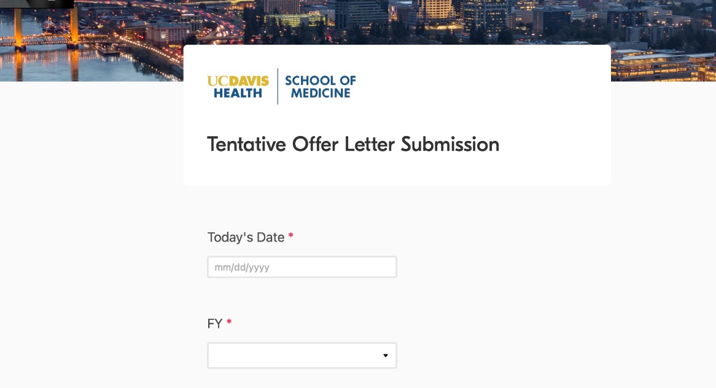
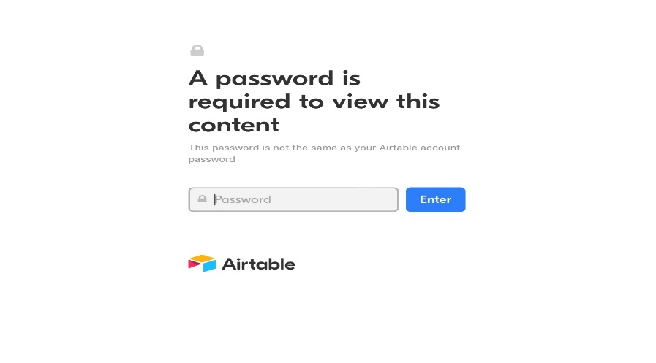
NEW TOL Submission Process
a
1. Open link to TOL Submission form ”Submit Tentative Offer Letters for Approval” on SOM AP website under the Recruitment Section. You will be directed to enter a password. The password is “aphealth” in all lowercase.
2. Enter “Today’s Date” by clicking in the box and selecting the date you are submitting the TOL.
3. Select the “Fiscal Year (FY)” using the drop-down menu. You will select the current fiscal year 2022-23.
4. All fields with asterisk are required and must be filled out.
19

Slide 20
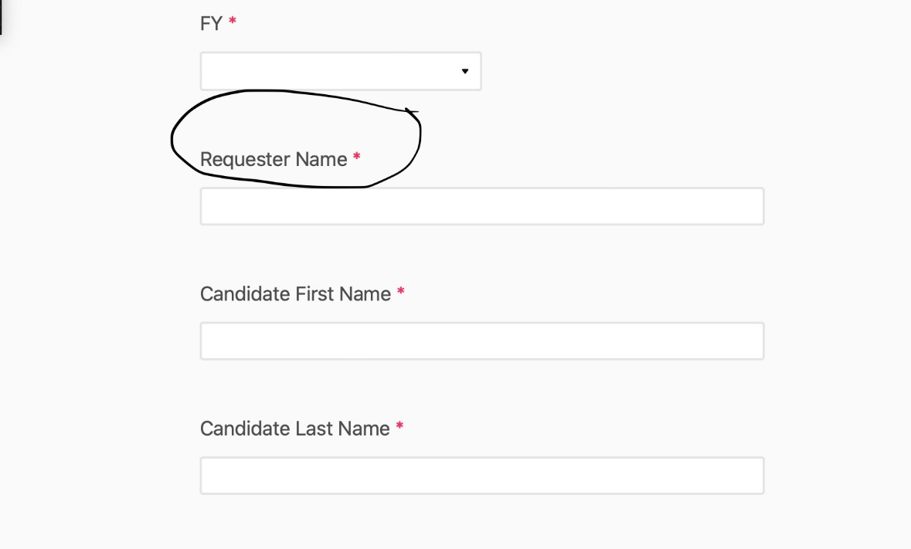
NEW TOL Submission Process
5. Enter “Requester Name ” by clicking in the box and entering your name (First and Last Name). Do not enter your nickname please. We should be able to use your full name to find your email address in the UCD directory if necessary.
6. Enter “Candidate’s First Name ” by clicking in the box and entering the final candidate’s first name as shown in the TOL and Curriculum Vitae (CV).
7. Enter “Candidate’s Last Name ” by clicking in the box and entering the final candidate’s last name as shown in the TOL and CV.
20

Slide 21
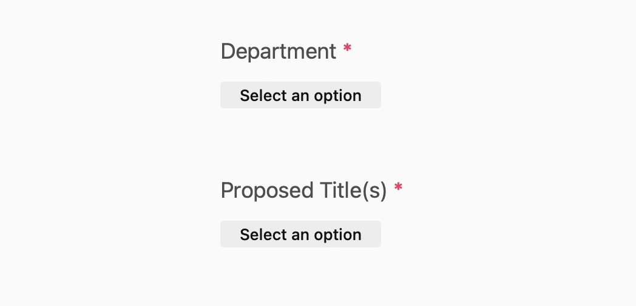
NEW TOL Submission Process
8. Select the “Department Name ” using the drop-down menu.
9. Select the “Proposed Title(s)” using the drop-down menu. If this is for a Reg/In-Res Split position, please select two options.
21

Slide 22
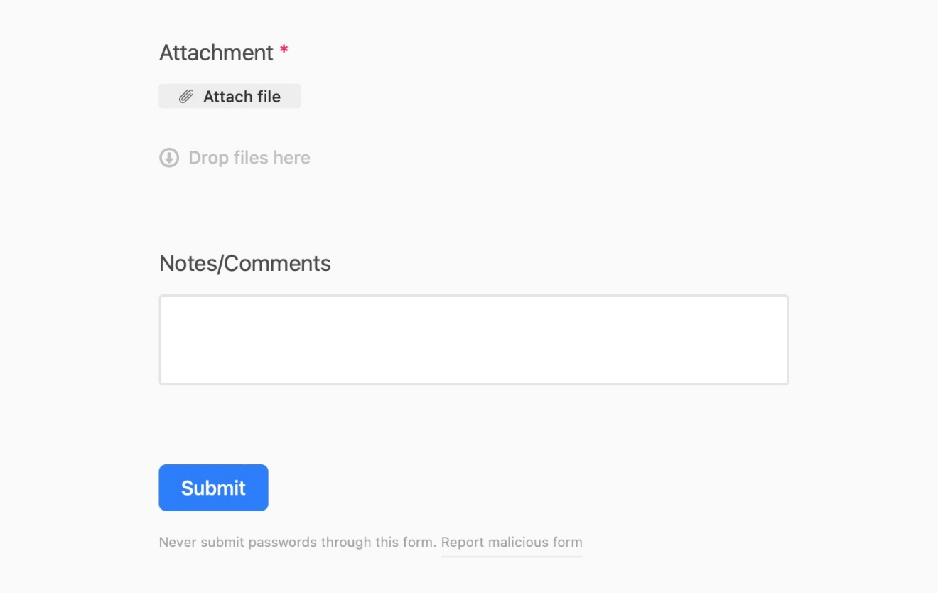
NEW TOL Submission Process
9. Upload your final draft TOL under “Attachment” by clicking attach file. Please use Word document when submitting your TOL.
10. Notes/Comments is not a required field; however, you may use this field to enter any pertinent information that will be helpful when your department RT Analyst is reviewing the offer letter.
11. Submit your form: After you have filled the required fields, click the blue “Submit” button
22

Slide 23

Timeline for Response and/or Approval
Departments are expected to have worked out the details regarding space, startup funds, etc. with the appropriate administrators in advance (i.e., the Hospital CEO, Vice Chancellor or Dean’s Office). Tentative Offer Letters (TOLs) should not be submitted for approval until the department has prior formal approval in these aspects
TOLs should be prepared on Department/Division letterhead. If Department letterhead is not available, please use UC Davis Health letterhead provided on the template. Departments should make every effort to submit an error free electronic copy to the Office of Academic Personnel Recruitment Team
The Recruitment Team analyst will review and circulate to the TOL Review Committee for comments and approvals if there are no edits to be made. The approval or suggested changes will be conveyed within three days. Some reasons that the approval maybe delayed are (i.e., letter requires grammatical and/or formatting corrections, startup of $1 million or more, or notification to the candidate’s current institution (APM 500) is required)
23

Slide 24

Pre-Hire Process
Pre-Hire Process effective 9/1/2022
Objective: To obtain an employee UCPath ID number prior to the employment start date to assist the department with access requests and onboarding only. The pre-hire is not an authorization for employee to start working prior to appointment approval.
Timeline: Department must provide Pre-Hire request no earlier than 30 days of appointment start date, and no later than two weeks of the appointment begin date.
AP Analyst will process the Pre-Hire transaction within 72 hours of receipt (this does not include the UCPath processing time, which may vary and take up to 3-5 working days for processing).
Initiation: The appointment dossier must be submitted to AP for the Pre-Hire to be initiated. Department to submit an AggieService- Onboarding case with the required data listed below.
AP submits the Pre-Hire via the appropriate Smart HR Transactions template.
24

Slide 25
Pre-Hire Process
Department must provide the following for the Pre-Hire data entry:
Appointment dossier completed and submitted to Academic Personnel
Position information to generate position number (Title, Job Code, Rank, FTE, Dept Code, Reports To PCN, Location, Patient Care y/n)
Employee Name
DOB, SSN, and Address (can obtain from the background check release form)
Background check clearance
Tracker profile creation and completion of Section 1
Completed Personal Data Form (including degree information)
25

Slide 26
Pre-Hire Process
Internal Process for the next steps to complete the employee record:
Confirm that the background check has cleared prior to appointment start date entry
Confirm that Section 1 and Section 2 of the I-9 are completed by the appropriate date(s)
Process any updates to DOB, SSN, and/or address by submitting a UC_PERSON_DATA template transaction
Confirm that the Oath/Patent are signed no later than the appointment start date. Update employee record with this information in Workforce Summary > Personal Information > Organizational Relationships > Person Checklist
If the appointment decision is not available by the payroll processing date, the “Pre-Hire” will be without salary and the employee will not be paid until the appointment is approved
Complete the appointment details by adding the Step, Salary and any other Job Data changes once the decision is available via PayPath
26

Slide 27

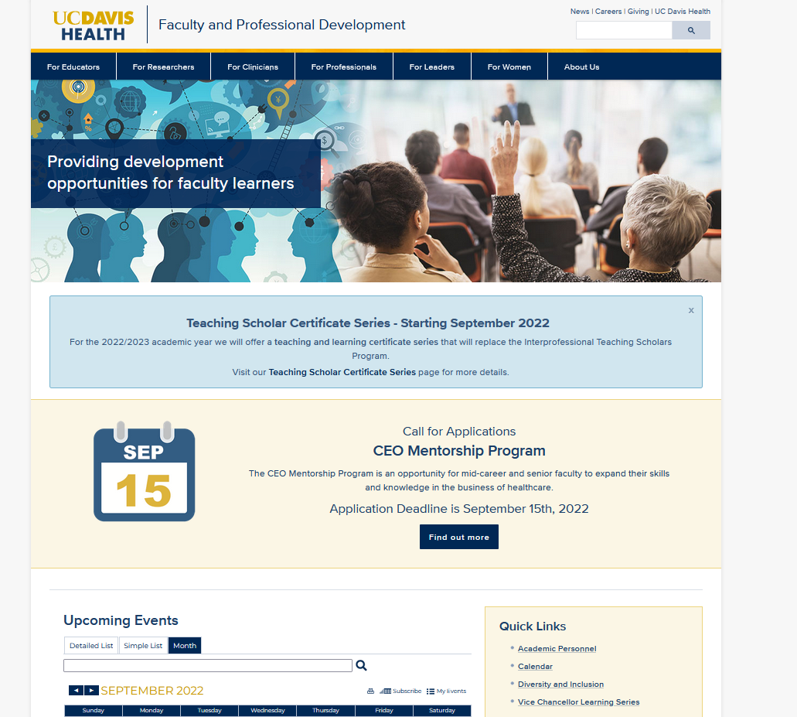
Faculty & Professional Development Updates
Renewed focus on providing more training sessions and making them more accessible:
  Faculty Essentials Workshops and Offerings - Faculty Development | UC Davis Health
  Vice Chancellor Learning Series | Faculty Development | UC Davis Health
Education programming changes
  NEW Launching new Teaching Certificate Programs:
    Inclusive Educator
    Clinical Teaching in the Classroom and in the Trenches
    Fundamentals of Learning and Course Development
Leadership programming changes
  NEW Thrive leadership and coaching webinars
  NEW CEO Mentorship Program
27
Notes:
New faculty workshop has been added to the offerings, December 16. All new faculty hired over the past year have been invited and are encouraged to attend. Register through the faculty development website
Renewed focus on providing more training sessions and making them more accessible:
Faculty Essentials Workshops and Offerings - Faculty Development | UC Davis Health (share screen, visit link)
New recordings of training sessions that are valuable to new faculty or faculty looking for a refresher.
Vice Chancellor Learning Series | Facutly Development | UC Davis Health (share screen, visit link)
Fundamentals for faculty, staff and students on negotiation, healthcare financing, and behavioral economics
Education programming changes
Ended Interprofessional Teaching Scholars Program
Launching new Teaching Certificate Programs:
Inclusive Educator
(starting today)
Clinical Teaching in the Classroom and in the Trenches,
(starting spring quarter)
Fundamentals of Learning and Course Development
(starting fall quarter 2023)
Leadership programming changes
Ended Academic Pathways or Paths to Leadership courses
Thrive leadership and coaching webinars
Lunch & Learn webinar series to learn actionable steps you can take to nurture your leadership,
Hosted throughout spring quarter and presented by physician executive coaches and leaders in medicine
Introduction to Coaching, Mentoring, and Sponsorship
Preventing Burnout and Practicing Wellness: Unpacking Perfectionism
Leadership style
Emotional Intelligence
CEO Mentorship Program
New program headed by Vice Chancellor & CEO Dr. Lubarsky for mid-late career faculty pursuing executive and high-level academic roles

Slide 28


Faculty & Professional Development Updates
Clinical programming
  Clinical time management -NEW
Other
  School of Medicine (SOM) Early Career Faculty Funding Opportunity
    14 recipients received 50k research funds to early-career biomedical researchers working on clinical research projects and facing extra-professional demands of caregiving increased by the COVID-19 pandemic
  Website update – calendar now includes all training sessions from CTSC, Ombuds office, HEDI
  Target audience expanding
28
Notes:
Clinical programming
Clinical time management
New offerings coming soon based on needs assessment that went out earlier this year
Other
School of Medicine (SOM) Early Career Faculty Funding Opportunity
14 recipients received 50k research funds to early-career biomedical researchers working on clinical research projects and facing extra-professional demands of caregiving increased by the COVID-19 pandemic
Received funding from the Doris Duke Charitable Foundation, Burroughs-Wellcome foundation and the UCD School of Medicine
Program includes mentorship and professional development opportunities
Website update – calendar now includes all training sessions from CTSC, Ombuds office, HEDI
All faculty and professional development trainings in white
Target audience expanding
Some training sessions are available now for students, residents, post-docs, nurse practitioners, physician assistants, and staff physicians
New Target Audience section on flyer

Slide 29
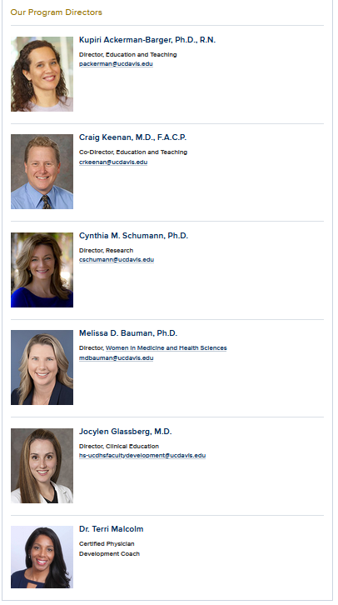

Faculty Development Resources
Website provides one-stop resource for workshops and opportunities for faculty professional development
Quarterly offerings of trainings in essential topics such as retirement, saving, outside professional activity, conflict management, compensation, crucial conversations and accountability, merits and promotions and more
R01 program for early career researchers offers mentorship, expert panel application review, professional development, resources and peer group activities
WIMHS Program provides peer support, networking opportunities, mentorship and resources for women in medicine and health sciences
29

Slide 30


Faculty and Professional Development
For questions regarding Faculty and Professional Development, mentoring, new programs, or to request an offering, please contact: hs-ucdhsfacultydevelopment@ucdavis.edu
Or visit: https://health.ucdavis.edu/facultydev/about-us/team
Please visit the website for training and program information and professional development resources for faculty: https://health.ucdavis.edu/facultydev
30

Slide 31


