Slide 1
Advance Care Planning and Legal Planning
Lori Baker, LCSW

Slide 2
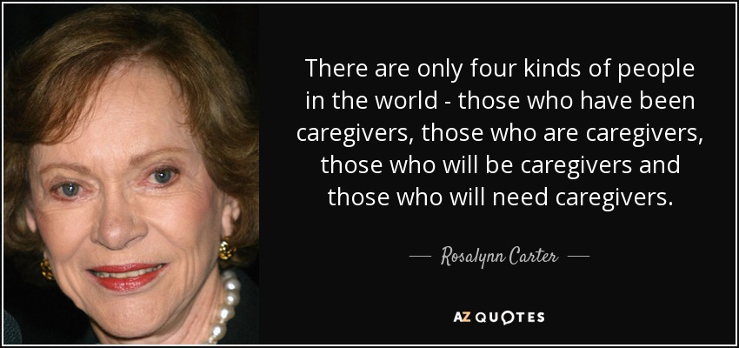

Slide 3
Rosalynn Carter Institute for Caregivers

Slide 4
Advance Care Planning (ACP)
Advanced Care Planning refers to all aspects of addressing a person’s care wants, possible needs and provide an appointed person to execute these wishes when the person unable to speak for themselves.
ACP is a process, not an event. It is the process of planning for future medical care and overall wellbeing in the event that the person is unable to make his or her own decisions.
During this process, the person explores, discusses, articulates, and documents their preferences.

Slide 5
Advance Care Planning (ACP)
-continues
The process helps the person identify and clarify their personal values and goals about health, medical treatment and overall care wishes.
They identify the care they would want, or not want, to receive in various situations.

Slide 6
Advance Care Planning (ACP)
-continues
The person also determines whom they would like to make health care decisions on their behalf in the event they cannot make decisions for themselves.
Ideally, advance care planning is a process of structured discussions and documentation woven into the regular process of care which should be reviewed/updated on a regular basis.

Slide 7
Advance Care Planning (ACP)
-continues
It is designed to ensure that a person’s wishes will be respected in the event that the person is unable to participate in decision making.

Slide 8
Advance Care Planning (ACP)
-continues
Summary
  1) Think, personal values and goals about health, medical treatment and overall care needs.
  2) Talk to primary care, medical team, family, friends and the person you are empowering to make decisions in your place (health care proxy, power of attorney for health care)
  3) Record wishes in either an advance health care directive, Five Wishes, living will, power of attorney for health care, Physician Orders for Life Sustaining Treatment (POLST)
  4) Share with our medical team, legal team, and your agent for health care

Slide 9
Power of Attorney for Health Care
Power of Attorney for Health Care-
  The agent has the ability to make health care decisions as well as having the responsibility to make sure doctors and other medical personnel provide necessary care according to the patient’s wishes.

Slide 10
My life is a story.
Can YOU Help Me With The Last Chapter!

Slide 11

Why Helping With The Last Chapter Matters!
What Most Of Us Want!
To live to the fullest
“Fix” disease
90% of us prefer to die
at home

Slide 12
Why Helping With The Last Chapter Matters!
What Most Of Us Get !
Diseases that can’t be “fixed”
Death at home: about 23%
Death in institutions: about 77%

Slide 13
Advocating for the care of your loved one with dementia
Important steps:
Share who the person is
Make their wishes clear
To help make sure their wishes are:
Known and Respected

Slide 14
ACP Benefits
End of life conversations are associated with:
  Better quality of life
  Reduced use of life sustaining treatment near death
  Earlier hospice referrals
  Care that is more consistent with patient preferences
  Patients who engage in ACP are more likely to have their wishes followed.
  Preparation for End Of Life is associated with improved bereavement.

Slide 15
Palliative Care
What You Should Know
Palliative Care, is specialized medical care for people with a serious illness. This type of care is focused on providing relief from the symptoms and stress of a serious illness. The goal is to improve quality of life for both the patient and the family.

Slide 16
Palliative Care
What You Should Know
1) Palliative care is received in variety of setting including, home, outpatient clinic, and hospital.
2) Medicare, Medi-Cal and most insurances plans cover palliative care.
3) How do you know if palliative care is right for your loved one?
    Chronic illnesses may include cancer, heart disease, lung disease, kidney disease, Alzheimer’s disease .
    Palliative care can be provided at any stage of an illness and along with symptomatic and preventive treatment.

Slide 17
Palliative Care
What You Should Know
4) What you can expect from palliative care, relief from symptoms such as pain, shortness of breath, fatigue, constipation, nausea, …
5) Who provides palliative care, a medical team of specialists.
6) The palliative care team works in partnership with your own doctors.
7) How does one get palliative care, ask your doctor, ask for a referral to a palliative care team.

Slide 18
What is Hospice?
Hospice care is a special kind of care that focuses on the quality of life for people and their caregivers who are experiencing an advanced, life-limiting illness.
Hospice care provides compassionate care for people in the last phases of incurable disease so that they may live as fully and comfortably as possible.
Hospice philosophy accepts death as the final stage of life: it affirms life but does not try to hasten or postpone death.

Slide 19
Tools to Help*
BOOKS
Being Mortal: Medicine and What Matters in the End A. Gawande, 2014
Dying Well: Peace and Possibilities at the End‐of‐Life I. Byock, 1998

Slide 20
WEBSITES
https://theconversationproject.org/wpcontent/uploads/2020/12/DementiaGuide.pdf
https://www.nia.nih.gov/health/what-are-palliative-care-and-hospice-care
https://capolst.org/wp-content/uploads/2020/10/POLST_2017_wCover.pdf

Slide 21

It’s easy to avoid completing an ACP!

Slide 22




Completing an ACP!
Giving the last chapter the importance deserved.

Slide 23
Advance Care Planning
Getting Your Affairs in Order
No one ever plans to be sick or disabled. Yet, it's this kind of planning that can make all the difference in an emergency.

Slide 24
Thank YOU!!
For Being A Caregiver
Lori Baker, LCSW
UC Davis Alzheimer’s Disease Center/Healthy Aging Clinic

